Slide 1
.NET/C# Training
Parthiban
30/10/2023
Notes:
This template can be used as a starter file for presenting training materials in a group setting.
Sections
Right-click on a slide to add sections. Sections can help to organize your slides or facilitate collaboration between multiple authors.
Notes
Use the Notes section for delivery notes or to provide additional details for the audience. View these notes in Presentation View during your presentation.
Keep in mind the font size (important for accessibility, visibility, videotaping, and online production)
Coordinated colors
Pay particular attention to the graphs, charts, and text boxes.
Consider that attendees will print in black and white or grayscale. Run a test print to make sure your colors work when printed in pure black and white and grayscale.
Graphics, tables, and graphs
Keep it simple: If possible, use consistent, non-distracting styles and colors.
Label all graphs and tables.

Slide 2
C# Methods
A method is a block of code which only runs when it is called.
You can pass data, known as parameters, into a method.
Methods are used to perform certain actions, and they are also known as functions.
Method Definition
static void MyMethod()
{
Console.WriteLine("I just got executed!");
}
static void Main(string[] args)
{
MyMethod();
}
Method Calling
Notes:
Give a brief overview of the presentation. Describe the major focus of the presentation and why it is important.
Introduce each of the major topics.
To provide a road map for the audience, you can repeat this Overview slide throughout the presentation, highlighting the particular topic you will discuss next.

Slide 3
Parameters and Arguments
Information can be passed to methods as parameter.
Parameters act as variables inside the method.
Method Definition
ReturnType MethodName(Parameter1,Parameter2,….ParameterN)
ReturnType MethodName(DataType Variable1, DataType Variable2 ,…. DataType VariableN)
static void MyMethod(string fname, int age)
{
Console.WriteLine(fname + " is " + age);
}
Notes:
Give a brief overview of the presentation. Describe the major focus of the presentation and why it is important.
Introduce each of the major topics.
To provide a road map for the audience, you can repeat this Overview slide throughout the presentation, highlighting the particular topic you will discuss next.

Slide 4
Parameters and Arguments
Method Calling
MethodName(Value1,Value2, ….ValueN)
MyMethod(“Dharmesh");
MyMethod(“Priya");
MyMethod(“Gopi");
Notes:
Give a brief overview of the presentation. Describe the major focus of the presentation and why it is important.
Introduce each of the major topics.
To provide a road map for the audience, you can repeat this Overview slide throughout the presentation, highlighting the particular topic you will discuss next.

Slide 5
Methods- Multiple Parameters
Mymethod with Two parameter
static void MyMethod(string fname, int age)
{
Console.WriteLine(fname + " is " + age);
}
MyMethod("Liam", 5);
MyMethod("Jenny", 8);
MyMethod("Anja", 31);
// Liam is 5
//Jenny is 8
// Anja is 31
MyMethod is called With Value 2 Values
Notes:
Give a brief overview of the presentation. Describe the major focus of the presentation and why it is important.
Introduce each of the major topics.
To provide a road map for the audience, you can repeat this Overview slide throughout the presentation, highlighting the particular topic you will discuss next.

Slide 6
Default Parameter Value
default parameter value, by using the equals sign (=).
ReturnType MethodName(Parameter1= value1,Parameter2=value2,….ParameterN=valueN)
static void MyMethod(string country = "Norway")
{
Console.WriteLine(country);
}
static void Main(string[] args)
{
MyMethod("Sweden");
MyMethod("India");b
MyMethod();
MyMethod("USA");
}
// Sweden
// India
// Norway
// USA
Default Parameter
Notes:
Give a brief overview of the presentation. Describe the major focus of the presentation and why it is important.
Introduce each of the major topics.
To provide a road map for the audience, you can repeat this Overview slide throughout the presentation, highlighting the particular topic you will discuss next.

Slide 7
Named Arguments
send arguments with the key: value syntax.
static void MyMethod(string child1, string child2, string child3)
{
Console.WriteLine("The youngest child is: " + child3);
}
static void Main(string[] args)
{
MyMethod(child3: "John", child1: "Liam", child2: "Liam");
}
// The youngest child is: John

Slide 8
C# Methods
A method is a block of code which only runs when it is called.
You can pass data, known as parameters, into a method.
Methods are used to perform certain actions, and they are also known as functions.
Method Definition
static void MyMethod()
{
Console.WriteLine("I just got executed!");
}
static void Main(string[] args)
{
MyMethod();
}
Method Calling
Notes:
Give a brief overview of the presentation. Describe the major focus of the presentation and why it is important.
Introduce each of the major topics.
To provide a road map for the audience, you can repeat this Overview slide throughout the presentation, highlighting the particular topic you will discuss next.

Slide 9
Operators in C#
int x = 100 + 50;
int sum1 = 100 + 50; // 150 (100 + 50)
int sum2 = sum1 + 250; // 400 (150 + 250)
int sum3 = sum2 + sum2; // 800 (400 + 400)
Operators are used to perform operations on variables and values.
Notes:
Give a brief overview of the presentation. Describe the major focus of the presentation and why it is important.
Introduce each of the major topics.
To provide a road map for the audience, you can repeat this Overview slide throughout the presentation, highlighting the particular topic you will discuss next.

Slide 10
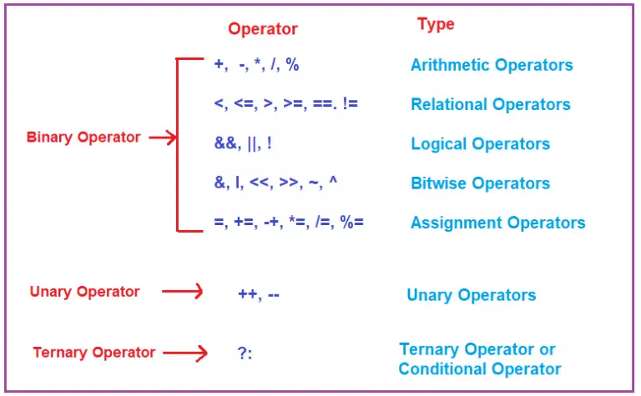
Operators in C#
Notes:
Give a brief overview of the presentation. Describe the major focus of the presentation and why it is important.
Introduce each of the major topics.
To provide a road map for the audience, you can repeat this Overview slide throughout the presentation, highlighting the particular topic you will discuss next.

Slide 11
Arithmetic Operators in C#
Operator | Name | Description | Example
+ | Addition | Adds together two values | x + y
- | Subtraction | Subtracts one value from another | x - y
* | Multiplication | Multiplies two values | x * y
/ | Division | Divides one value by another | x / y
% | Modulus | Returns the division remainder | x % y
++ | Increment | Increases the value of a variable by 1 | x++
-- | Decrement | Decreases the value of a variable by 1 | x--
Notes:
Give a brief overview of the presentation. Describe the major focus of the presentation and why it is important.
Introduce each of the major topics.
To provide a road map for the audience, you can repeat this Overview slide throughout the presentation, highlighting the particular topic you will discuss next.

Slide 12
Arithmetic Operators
Operator | Example | Same As
= | x = 5 | x = 5
+= | x += 3 | x = x + 3
-= | x -= 3 | x = x - 3
*= | x *= 3 | x = x * 3
/= | x /= 3 | x = x / 3
%= | x %= 3 | x = x % 3
Notes:
Give a brief overview of the presentation. Describe the major focus of the presentation and why it is important.
Introduce each of the major topics.
To provide a road map for the audience, you can repeat this Overview slide throughout the presentation, highlighting the particular topic you will discuss next.

Slide 13
Comparison Operators
Comparison operators are used to compare two values (or variables).
int x = 5; int y = 3;
Console.WriteLine(x > y); // returns True because 5 is greater than 3
Operator | Name | Example
== | Equal to | x == y
!= | Not equal | x != y
> | Greater than | x > y
< | Less than | x < y
>= | Greater than or equal to | x >= y
<= | Less than or equal to | x <= y
Notes:
Give a brief overview of the presentation. Describe the major focus of the presentation and why it is important.
Introduce each of the major topics.
To provide a road map for the audience, you can repeat this Overview slide throughout the presentation, highlighting the particular topic you will discuss next.

Slide 14
AND
Input1 | Input2 | Result
True | True | True | y=5,y=5,z=5 (x==y) && (y==z
True | False | False
False | True | False
False | False | False
OR
Input1 | Input2 | Result
True | True | True
True | False | True
False | True | True
False | False | False

Slide 15
Logical Operators
Logical operators are used to determine the logic between variables or values:
True or False values with logical operators.
Operator | Name | Description | Example
&& | Logical and | Returns True if both statements are true | x < 5 && x < 10
|| | Logical or | Returns True if one of the statements is true | x < 5 || x < 4
! | Logical not | Reverse the result, returns False if the result is true | !(x < 5 && x < 10)
Notes:
Give a brief overview of the presentation. Describe the major focus of the presentation and why it is important.
Introduce each of the major topics.
To provide a road map for the audience, you can repeat this Overview slide throughout the presentation, highlighting the particular topic you will discuss next.

Slide 16
C# Math
perform mathematical tasks on numbers
Math.Max(x,y)
The Math.Max(x,y) method can be used to find the highest value of x and y:
Math.Min(x,y)
The Math.Min(x,y) method can be used to find the lowest value of of x and y:
Math.Sqrt(x)
The Math.Sqrt(x) method returns the square root of x:

Slide 17
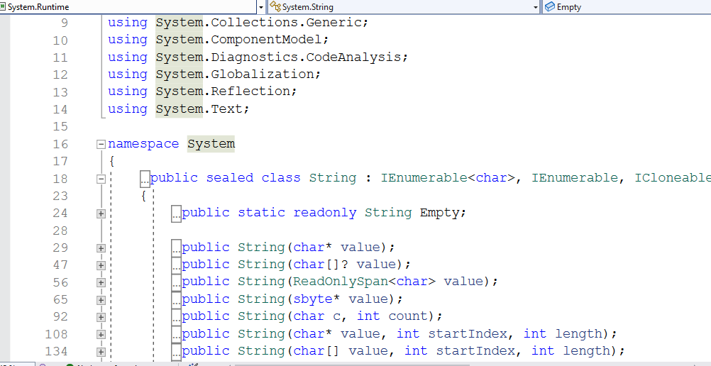
String Class
Namespace:System

Slide 18
C# Strings
string txt = "ABCDEFGHIJKLMNOPQRSTUVWXYZ"; Console.WriteLine("The length of the txt string is: " + txt.Length);
string txt = "Hello World";
Console.WriteLine(txt.ToUpper());
// Outputs "HELLO WORLD"
Console.WriteLine(txt.ToLower());
// Outputs "hello world"

Slide 19
String Concatenation
string.Concat()
string firstName = "John ";
string lastName = "Doe";
string name = string.Concat(firstName, lastName);
Console.WriteLine(name);
Adding Numbers and Strings
int x = 10;
int y = 20;
int z = x + y; // z will be 30 (an integer/number)
string x = "10";
string y = "20";
string z = x + y; // z will be 1020 (a string)

Slide 20
String Interpolation
string firstName = "John";
string lastName = "Doe";
string name = $"My full name is: {firstName} {lastName}";
Console.WriteLine(name);
Access Strings
You can access the characters in a string by referring to its index number inside square brackets [].
string myString = "Hello";
Console.WriteLine(myString[0]); // Outputs "H"
H | E | L | L | O
0 | 1 | 2 | 3 | 4

